Slide 1
Introduction to gender studies

Slide 2
Speakers
邱鼎文（Dingwen Qiu）
PhD candidate, School of CHL, CAP, ANU
Research interests: Social changes, Aspirations, and international schools in China
徐海月（Haiyue Xu）
PhD candidate, School of CHL, CAP, ANU
Research interests: Family relations, Gender and class inequalities in China

Slide 3
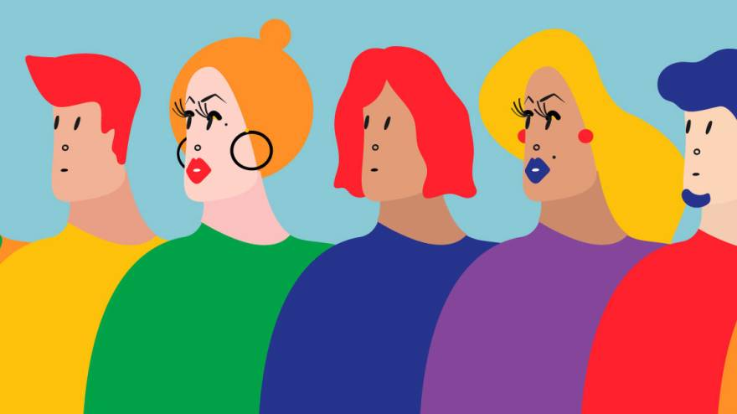
Reflections on Gender
﻿﻿How is gender relevant to your identity?
﻿﻿Have a look at the objects you have with you today:
﻿﻿Do they express/reflect gender identity?
﻿﻿Or some other aspect of identity?

Slide 4

Reflections on Gender
"Gender is so much the routine ground of everyday activities that questioning its taken-for-granted assumptions and presuppositions is like thinking about whether the sun will come up"
Lorber 1994
Paradoxes of Gender
Judith Lorber
Copyright Date: 1994
Published by: Yale University Press
Pages: 436
https://www.jstor.org/stable/j.ctt1bhkntg
Search for reviews of this book

Slide 5
What is gender studies?
Introductory Concepts:
Gender as socially constructed
﻿﻿Gender as a social institution or social structure and system of meanings
﻿﻿Gender & sexuality as aspects of identity
﻿﻿Gender as intertwined with other aspects of identity and other social structures
﻿﻿Gender, power and inequality (includes feminist activism and scholarship)

Slide 6
Introductory Concepts

Slide 7
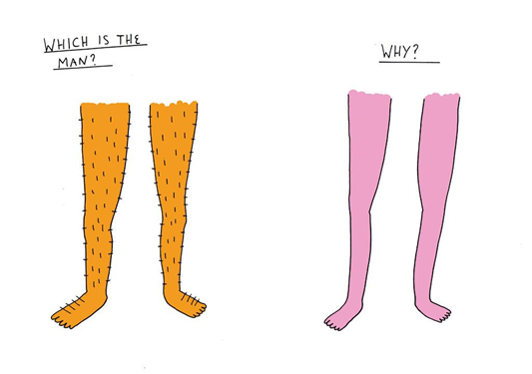
Introductory Concepts
Gender is one of the major ways that human beings organise their lives
Notes:
"Gender Stereotyping" by sickboyy is licensed under CC BY-NC-ND 2.0

Slide 8


Introductory Concepts
Gender in the West: The Binary Model

Slide 9
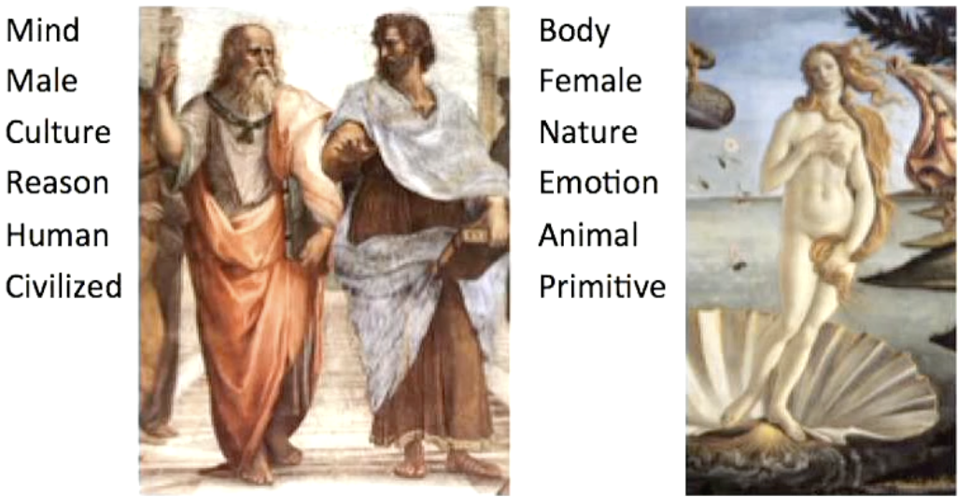
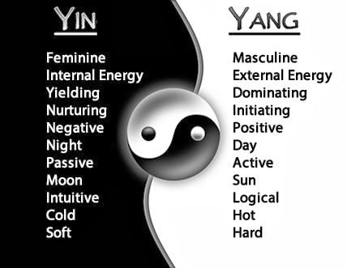
Introductory Concepts
Male/Female binary associated with other oppositions in philosophical thought

Slide 10
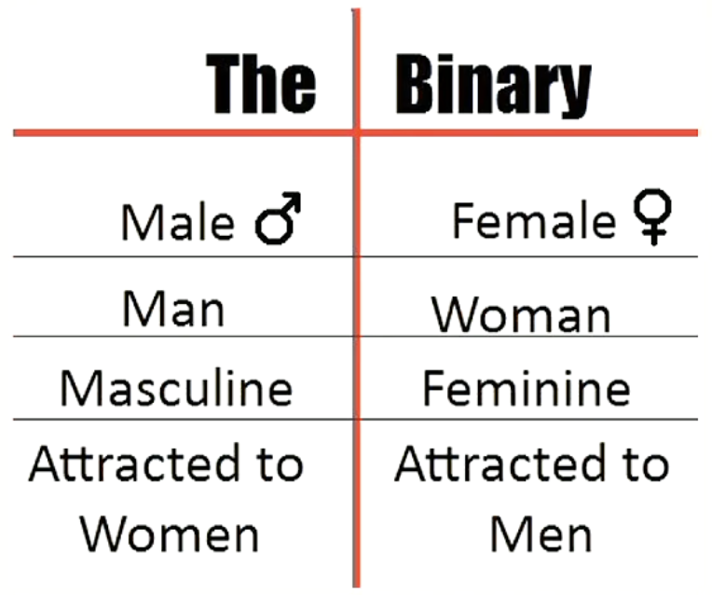

Introductory Concepts
Gender Order/Gender Regime
(See Connell, 2002)

Slide 11
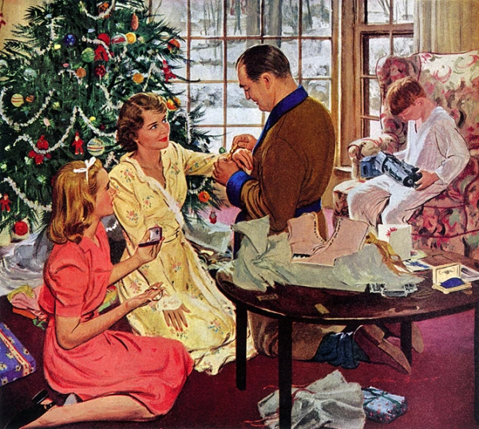
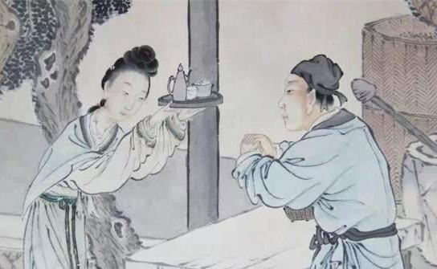
Introductory Concepts
Gender as a social structure

Slide 12
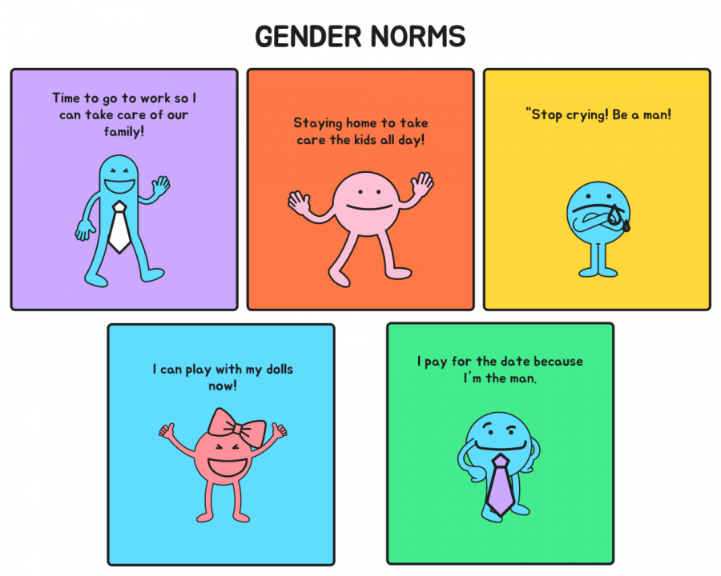
Introductory Concepts
Gender norms

Slide 13
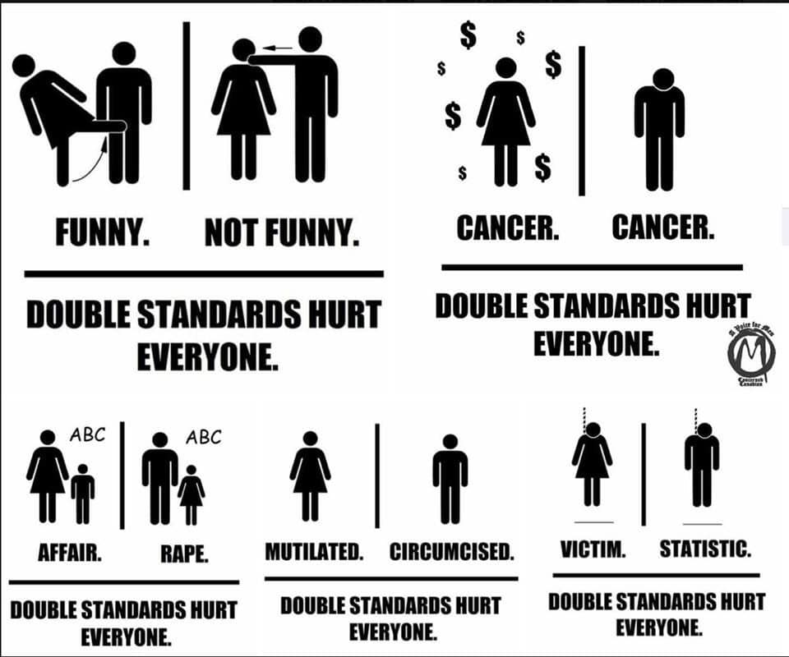
Introductory Concepts
Gender: Inequality, Conflict, Power, Struggle
https://www.reddit.com/r/MensRights/comments/bxuxov/gender_double_standards_infographic/

Slide 14
The Sex/Gender Distinction

Slide 15
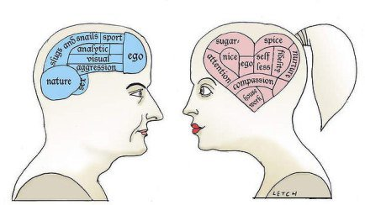
The Sex/Gender Distinction
View 1: Gender as natural

Slide 16
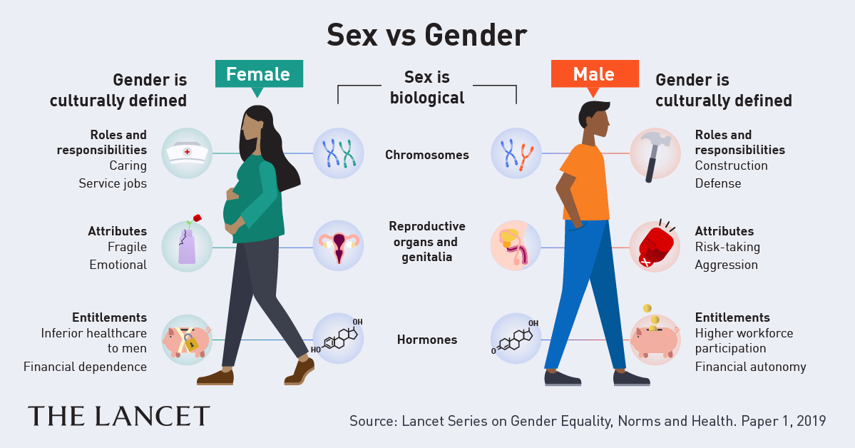
The Sex/Gender Distinction
View 2: Gender as socially constructed

Slide 17
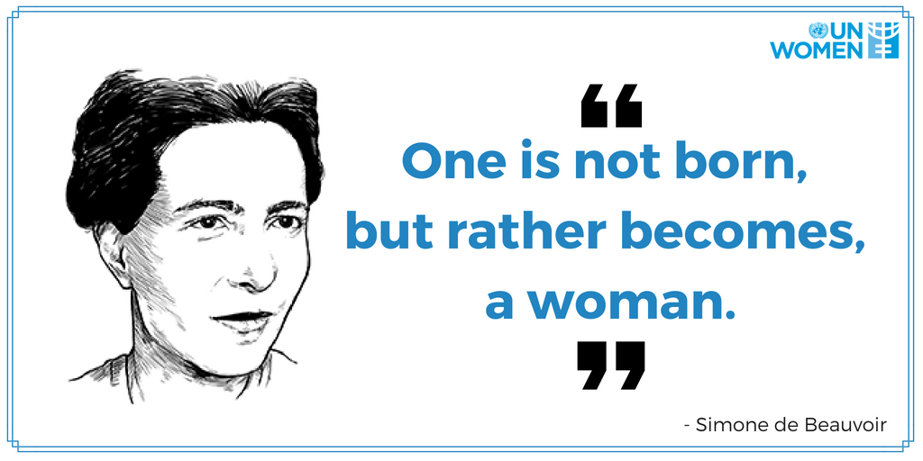
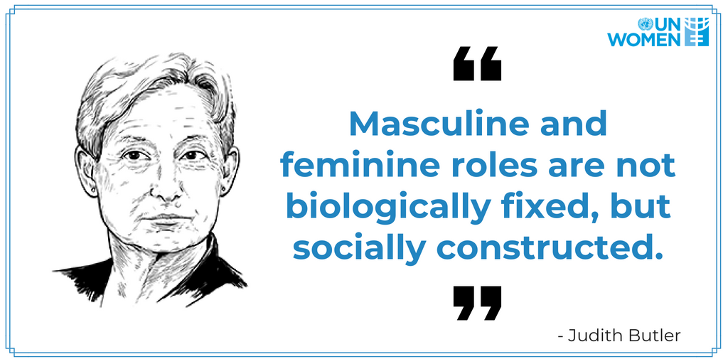
The Sex/Gender Distinction
Simone de Beauvoir, The Second Sex, 1949
Judith Butler, Gender Trouble, 1990

Slide 18
The Sex/Gender Distinction
'Sex refers to the biological apparatus...the male and the female...our chromosomal, chemical, anatomical organisation. Gender refers to the meanings that are attached to those differences within a culture.
Sex is male and female; gender is masculinity and femininity-what it means to be a man or a woman'
Kimmel, M. S. (2002). 'Gender symmetry' in domestic violence: A substantive and methodological research review. Violence Against Women, 8(11), 1332-1363. https://doi.org/10.1177/107780102762478037

Slide 19
Constructing Gender

Slide 20
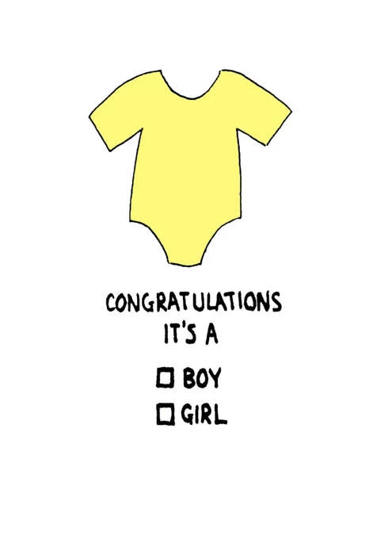
Constructing Gender
'For the individual, gender construction starts with assignment to a sex category on the basis of what genitalia look like at birth.
Judith Lorber, The Social Construction of Gender

Slide 21
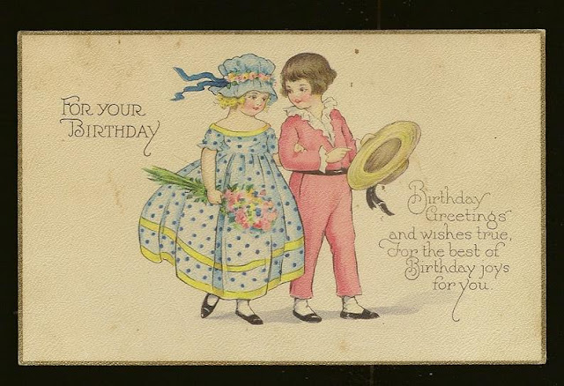

Constructing Gender
' A sex category becomes a gender through naming, dress and the use of other gender markers'
Judith Lorber, The Social Construction of Gender
Notes:
An archival birthday card from the 1910s with a girl in a blue frock, and a boy in a pink suit.
'The generally accepted rule is pink for the boys, and blue for the girls. The reason is that pink, being a more decided and stronger color, is more suitable for the boy, while blue, which is more delicate and dainty, is prettier for the girl

Slide 22
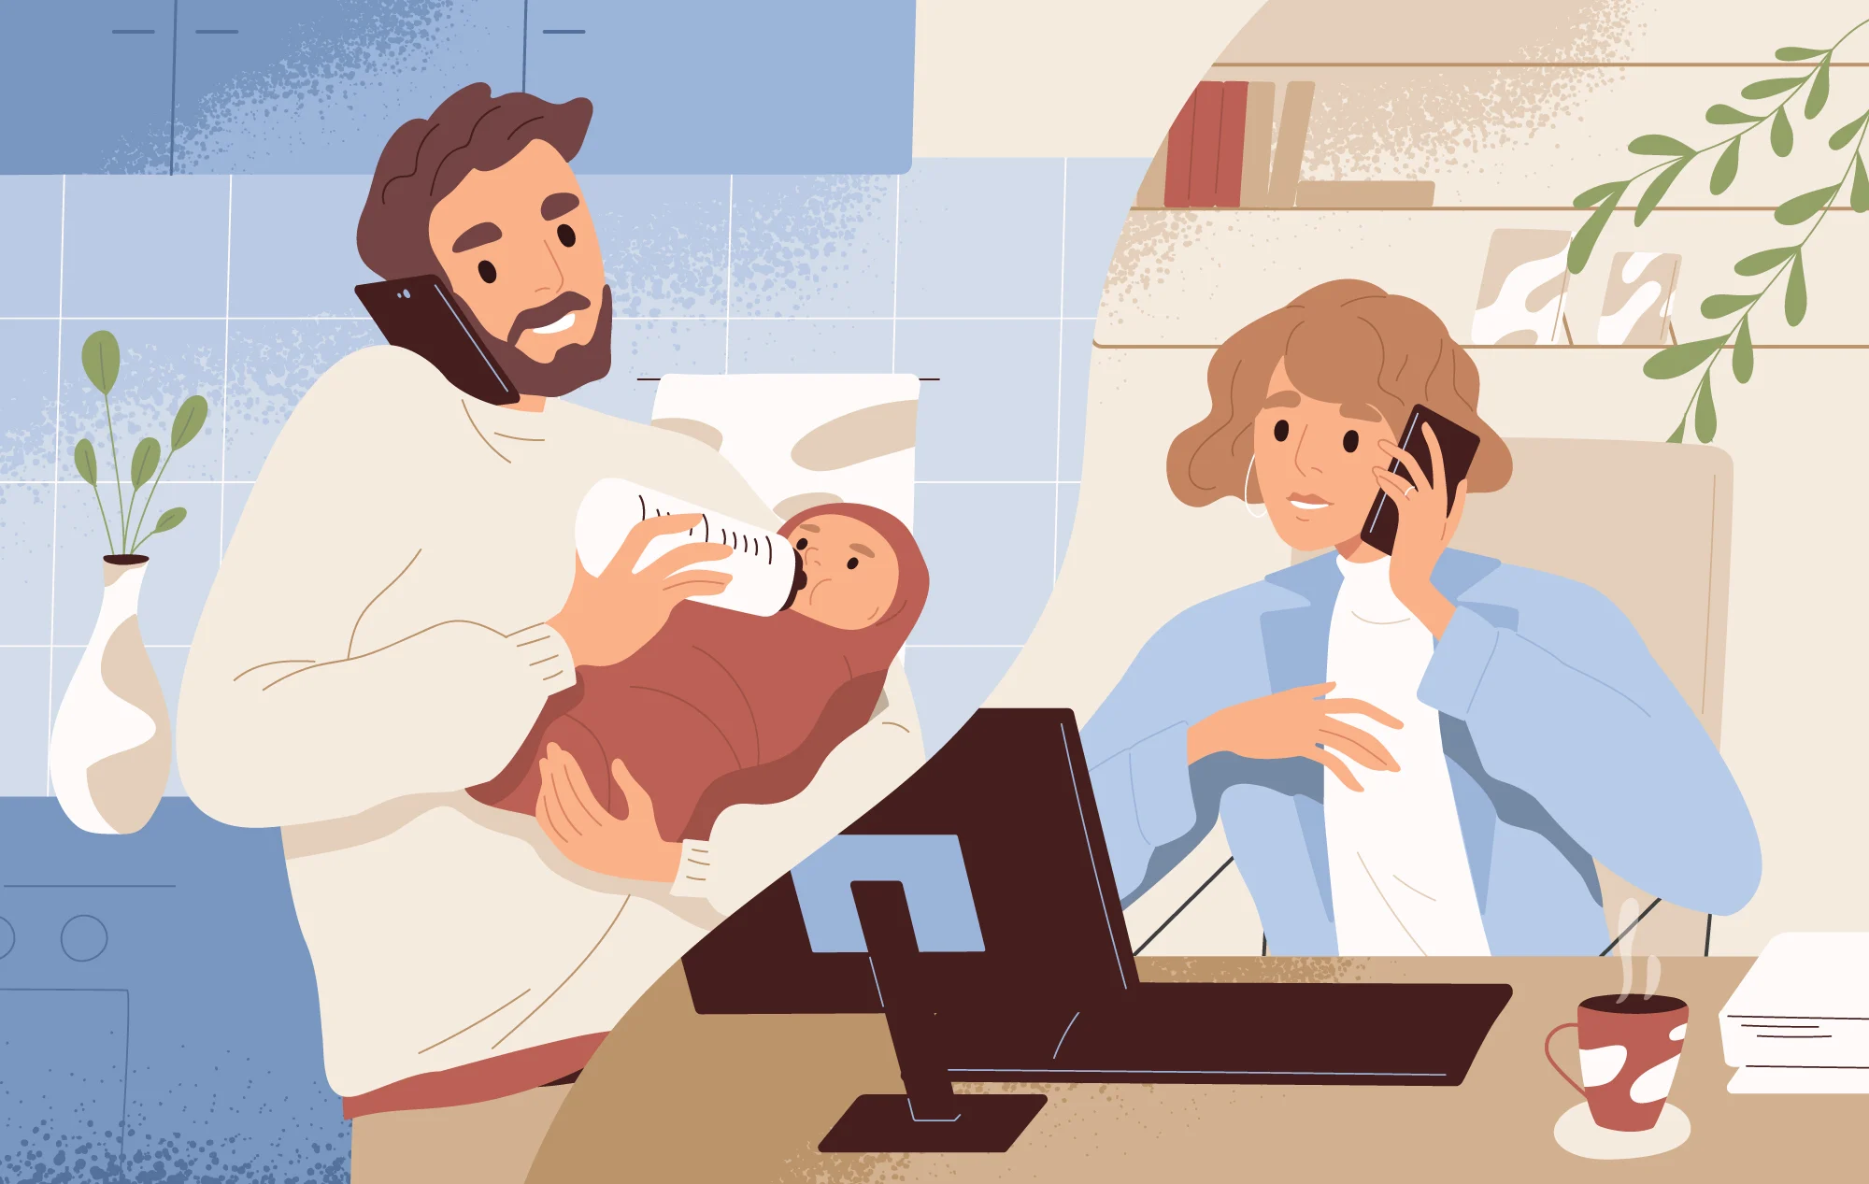
Constructing Gender
'Doing' gender

Slide 23
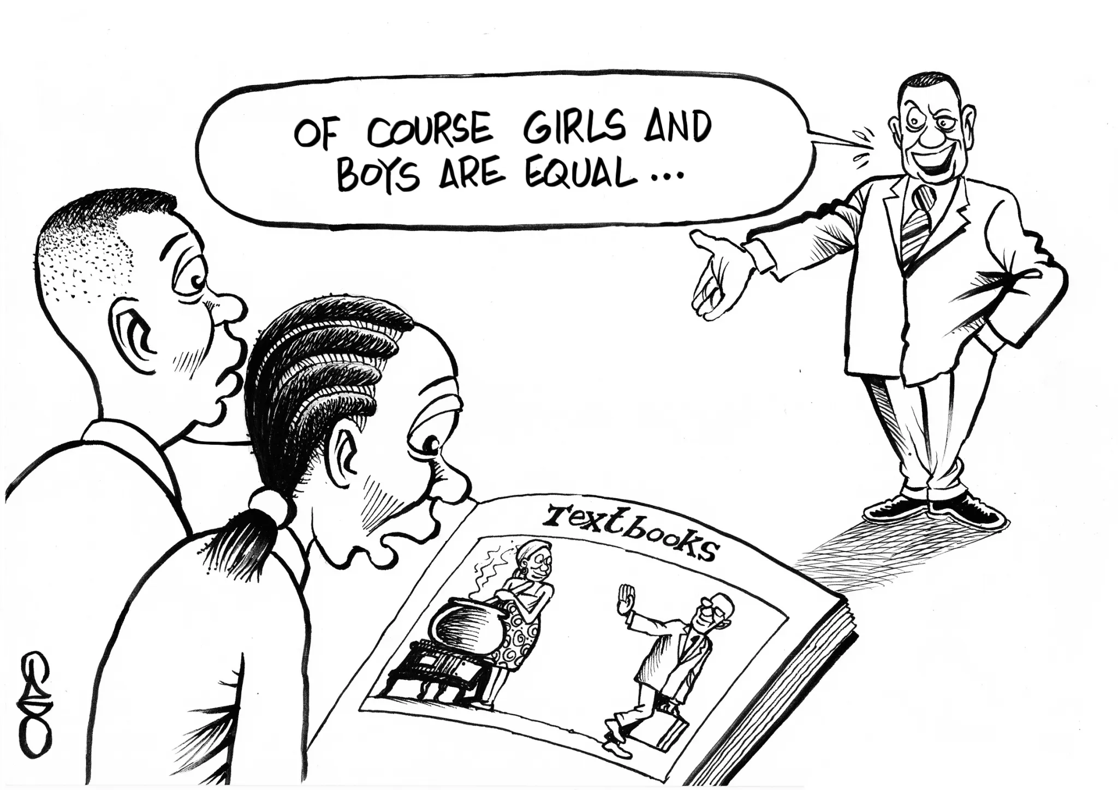
Constructing Gender
'Doing' gender or having it done to us?

Slide 24
Gender as Social Stratification

Slide 25

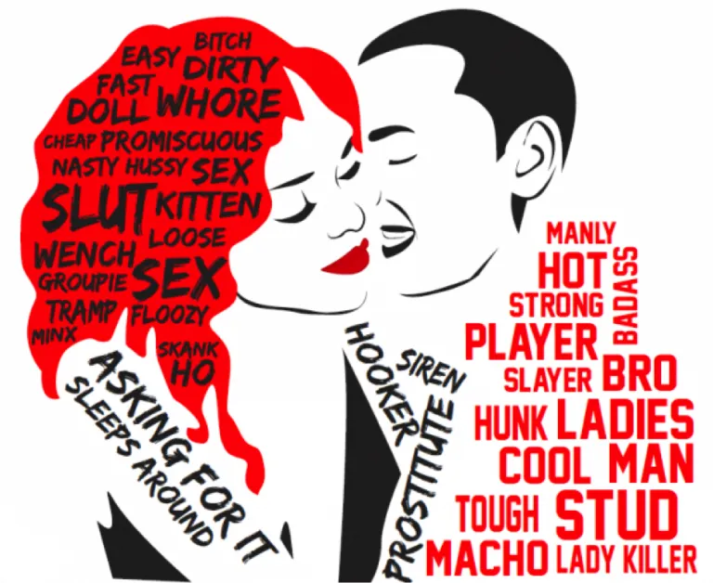
Gender as Social Stratification
Social stratification: when differences lead to one group having more status, power or privilege than another

Slide 26
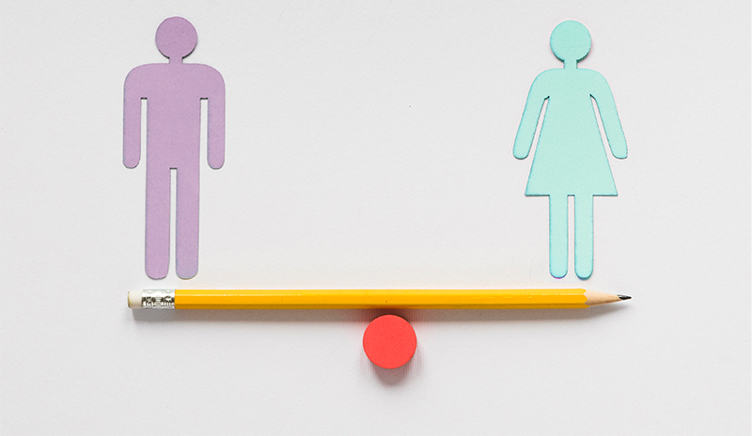
Gender as Social Stratification
The big questions:
﻿﻿Do we live in a gender stratified society?
﻿﻿Do men as a group have more access to power & resources than women as a group?

Slide 27
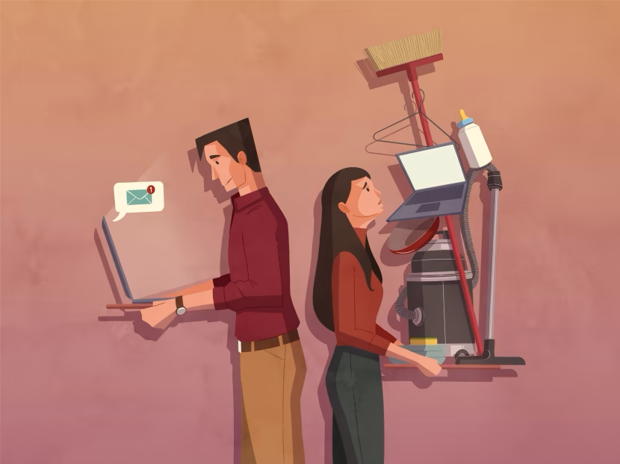

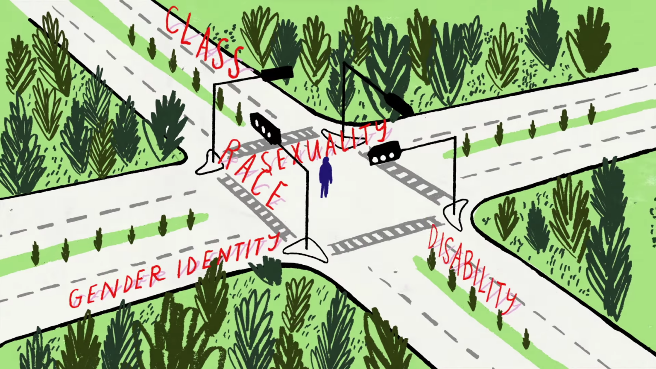
Gender as Social Stratification
More big questions:
﻿﻿How does gender interact with other forms of stratification such as race, class, sexuality, age, (dis)ability?
﻿﻿Is inequality an inevitable aspect of gender?
﻿﻿Does dividing humans into categories always produce stratification?

Slide 28
Thank you！
Contact Us
邱鼎文
Dingwen.qiu@anu.edu.au
微信：AQNDUW
徐海月
Haiyue.xu@anu.edu.au
微信：XHYANU

